Slide 1
Gara6
Plamena Georgieva – UX/UI designer, QA, Analyst -
1801261063
Katerina Raztsvetnikova – Project manager, Developer, Analyst - 1801261055

Slide 2
Description
Gara6 is an online vehicle management platform for helping people organize everything about their vehicle/vehicle park. It provides an easy and convenient way to introduce liability insurance, annual technical inspection, tax, vignette, tracking fuel consumption by various indicators, etc. In addition to the above, the client receives automatic notification by e-mail and Viber for upcoming events. The platform gives you the ability to customize the "documents'' of your vehicle according to the needs you have.

Slide 3
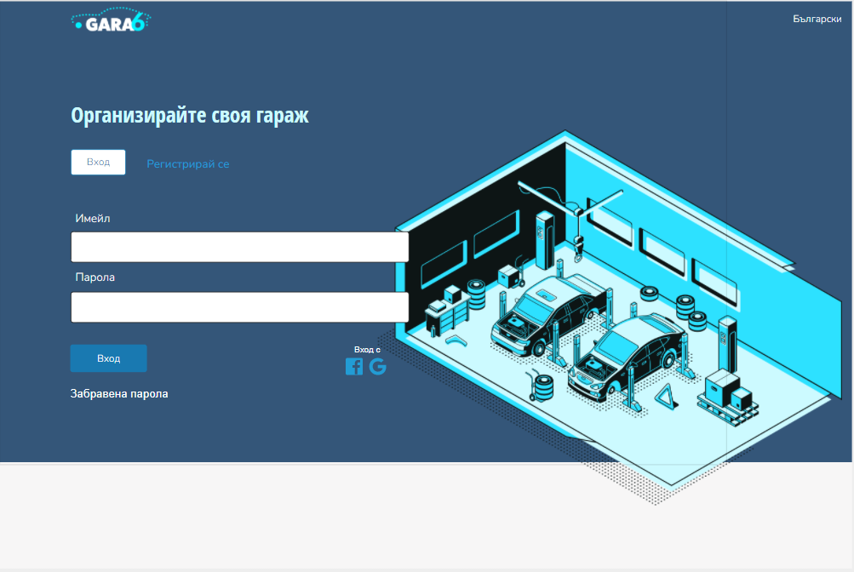
Screens
Login screen – Plamena Georgieva

Slide 4
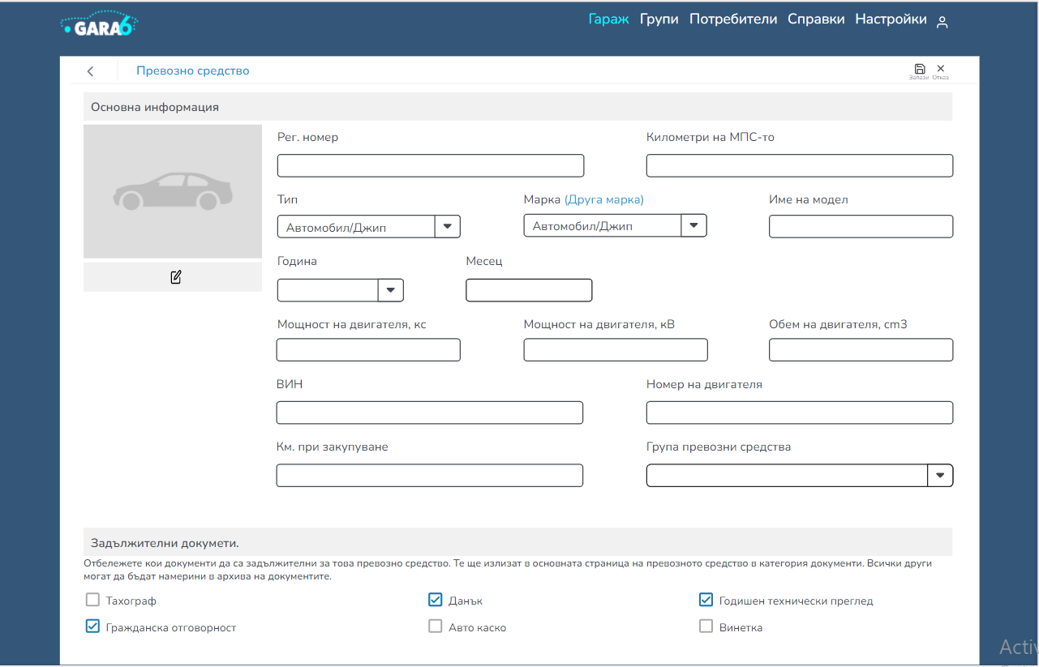
Add new vehicle – Plamena Georgieva

Slide 5
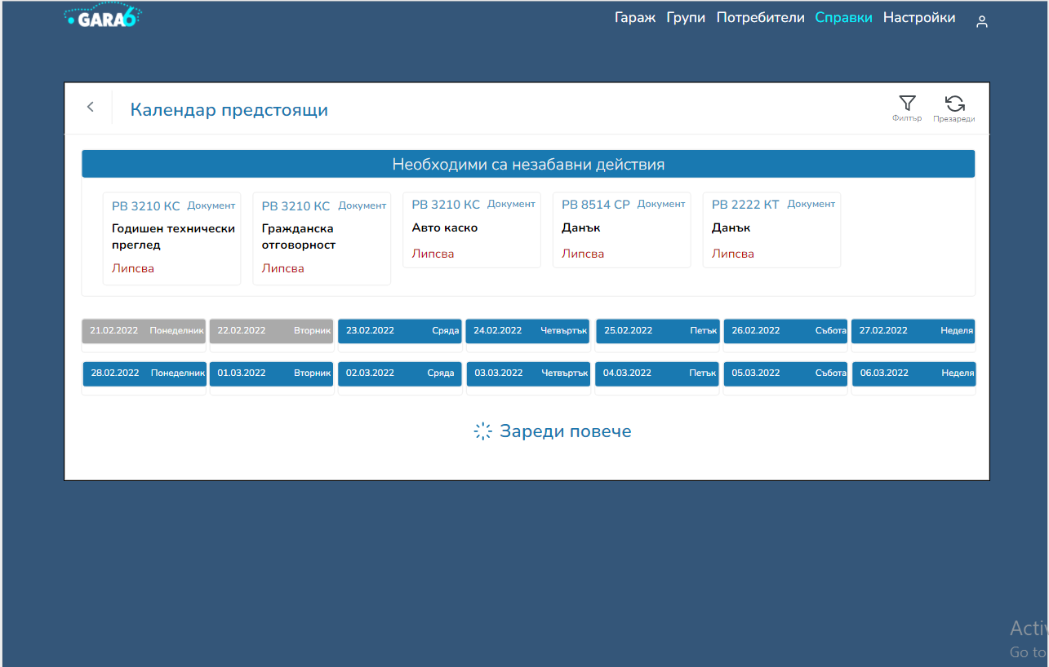
Calendar report – Katerina Raztsvetnikova

Slide 6
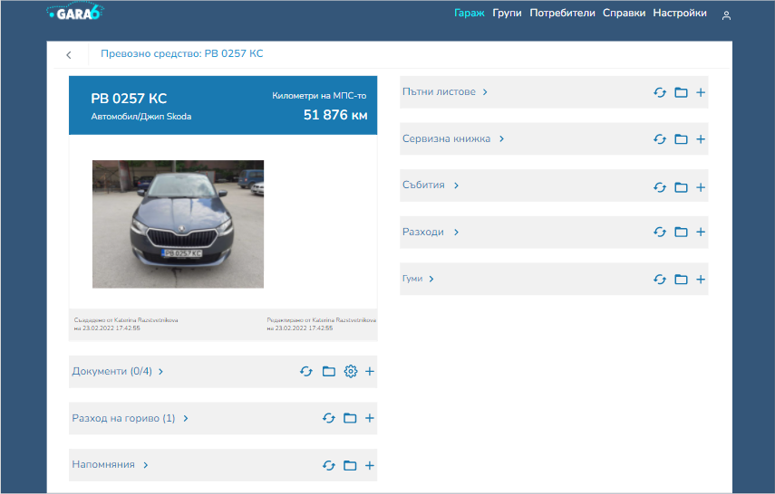
Vehicle view – Katerina Raztsvetnikova

Slide 7
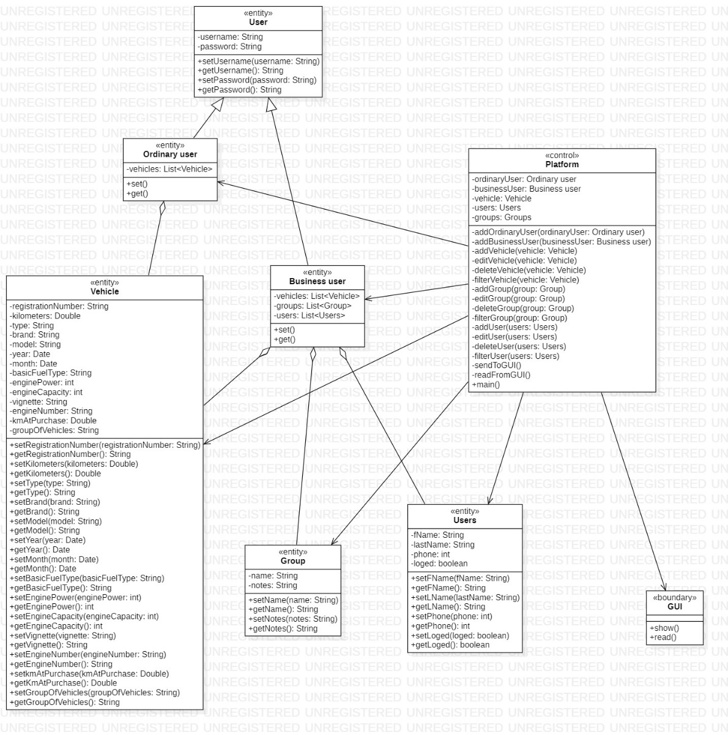
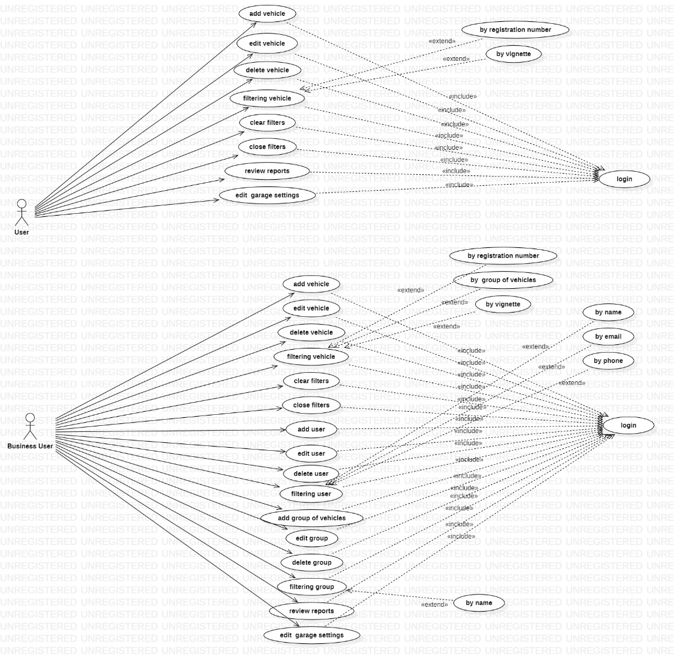
Diagrams
Use case diagram – Plamena Georgieva
Class diagram – Katerina Raztsvetnikova

Slide 8
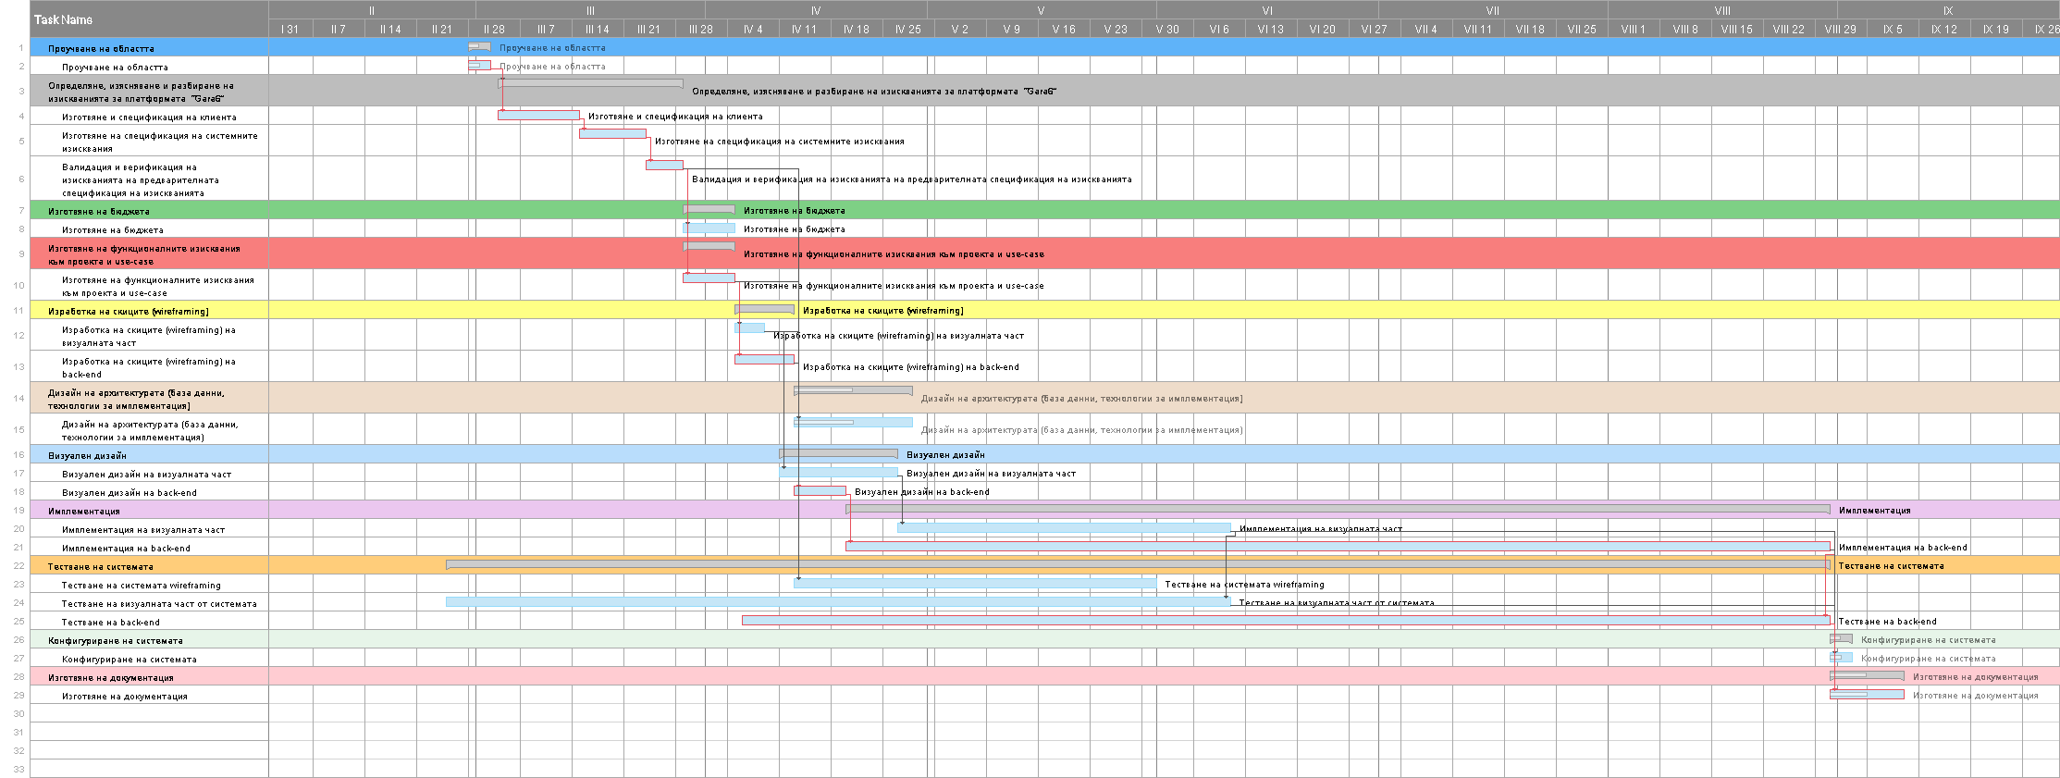
Gantt Chart
Plamena Georgieva, Katerina Raztsvetnikova

Slide 9
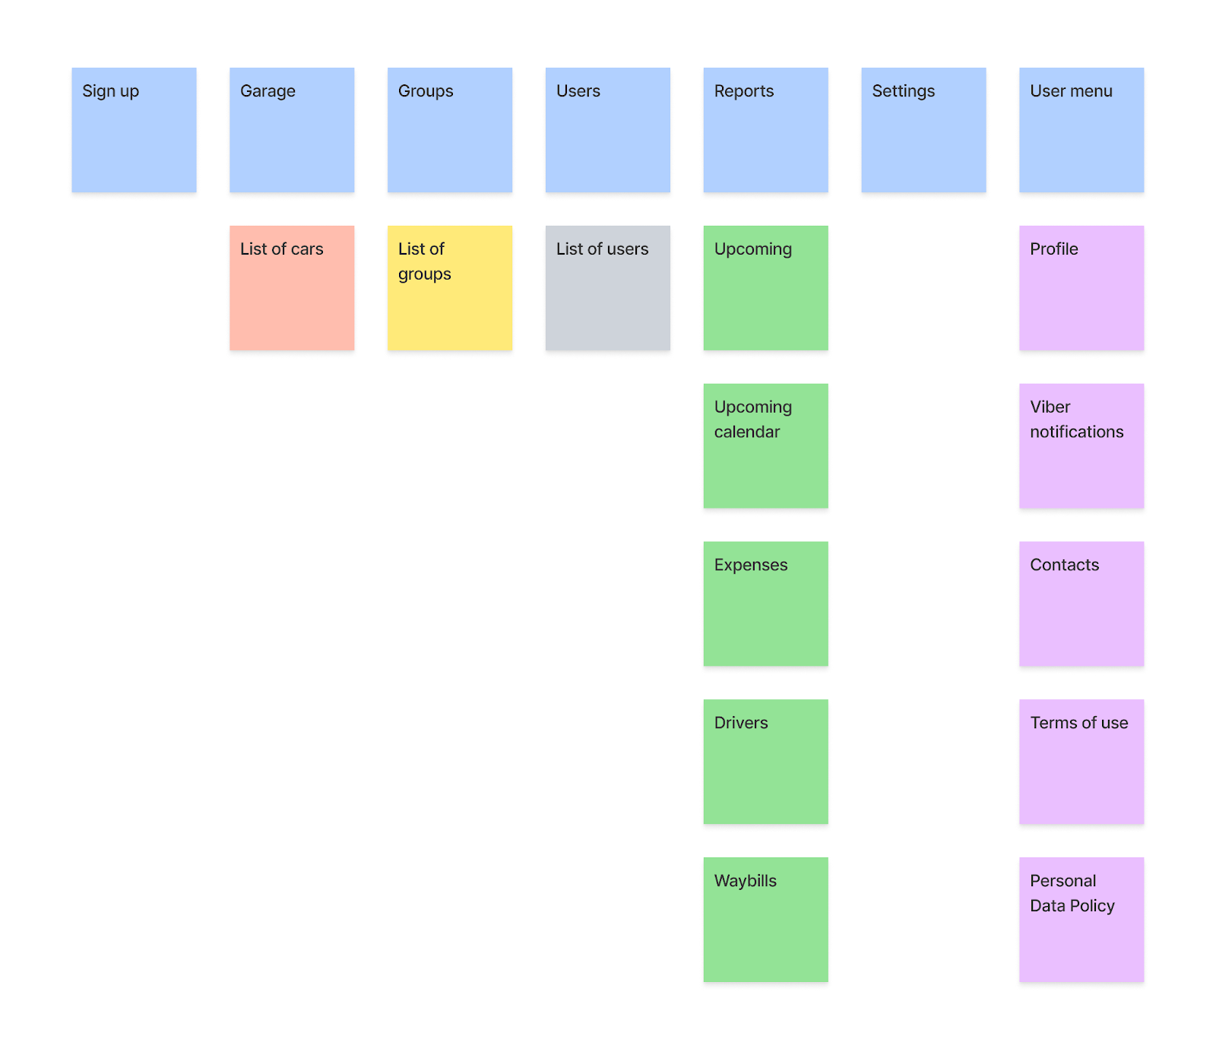
Test Cases
Card Sorting
Katerina Raztsvetnikova

Slide 10
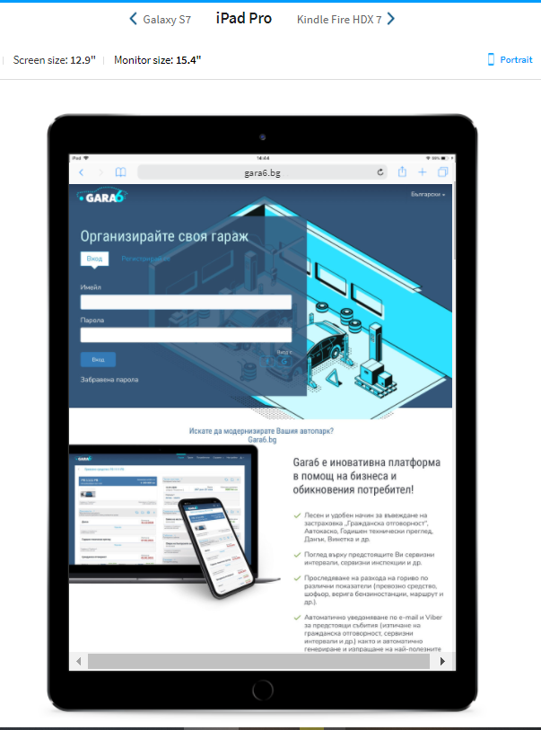
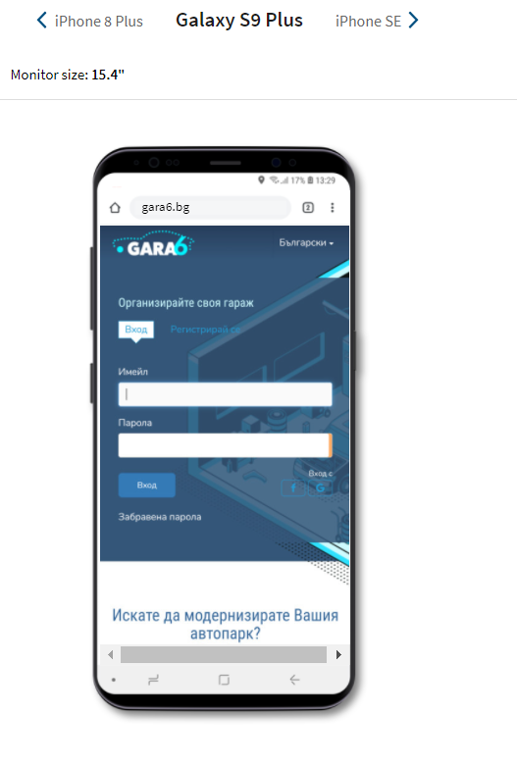
Responsive Design
Plamena Georgieva

Slide 11
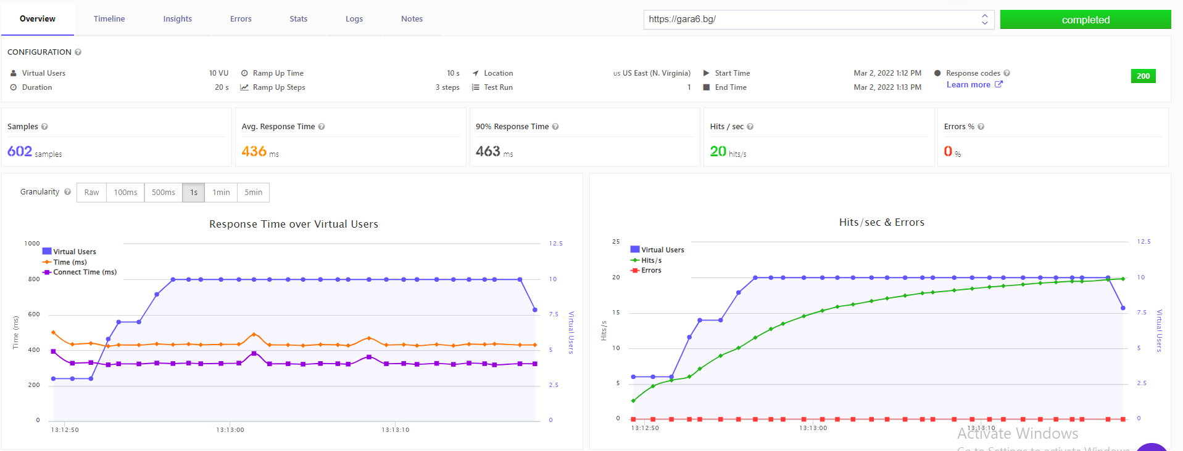
Load Testing
Plamena Georgieva

Slide 12
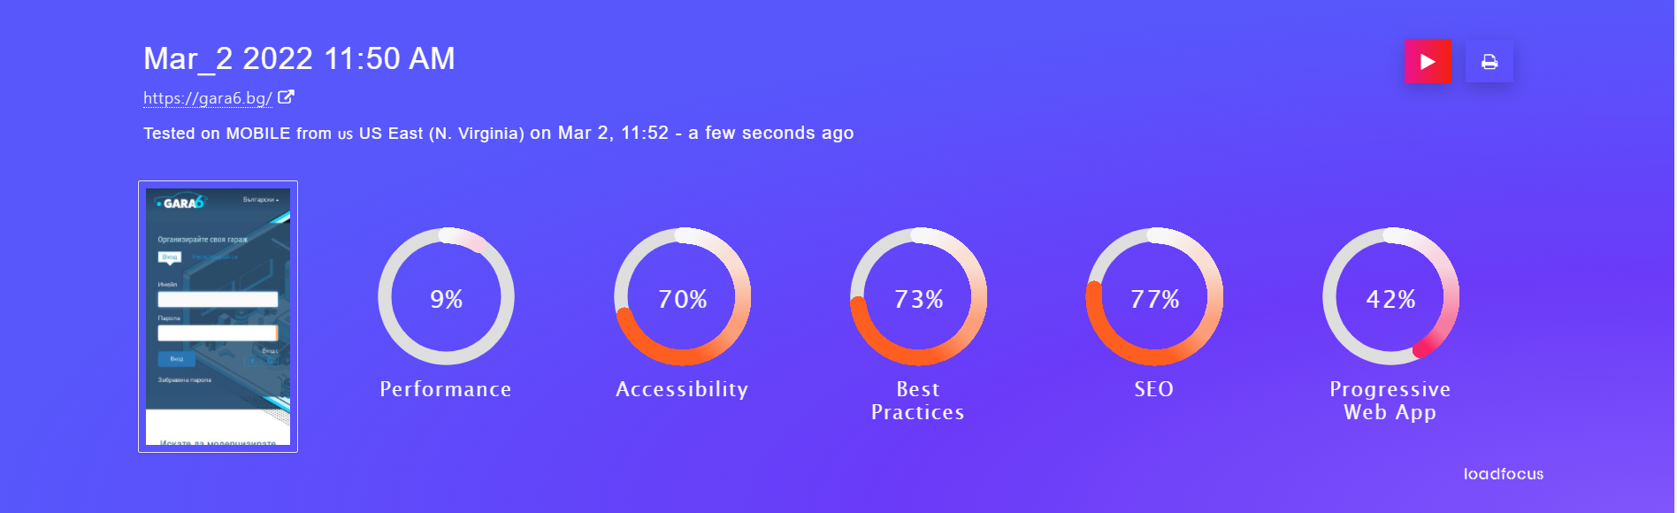
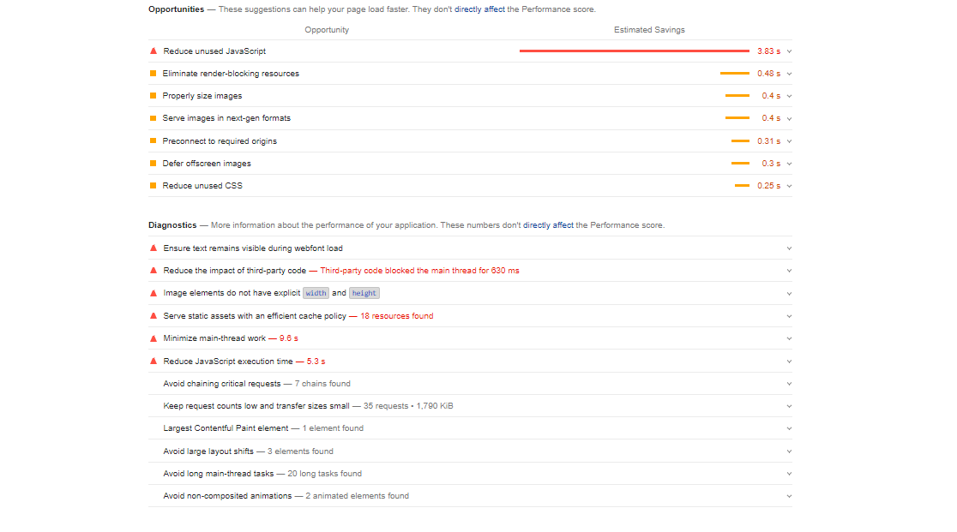
Web performance monitoring
Katerina Raztsvetnikova

